Slide 1
Timeline
2020
2019
2018
Step 06
2017
Step 05
Download this awesome diagram. Pitch your ideas convincingly.
2016
Step 04
Download this awesome diagram. Pitch your ideas convincingly.
2015
Step 03
Download this awesome diagram. Pitch your ideas convincingly.
Step 02
Download this awesome diagram. Pitch your ideas convincingly.
Step 01
Download this awesome diagram. Pitch your ideas convincingly.
Download this awesome diagram. Pitch your ideas convincingly.

Slide 2
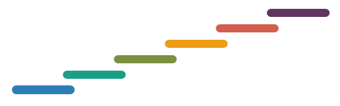
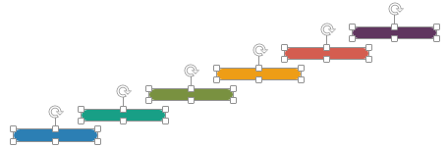
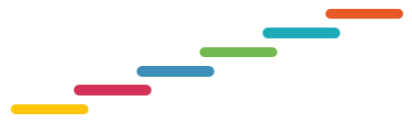
All images are 100% editable in PowerPoint
“Change color, size and orientation of any icon to your liking”

Slide 3
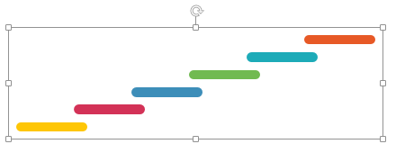

Ungrouping the object
1
2
3
The icons we have shown are just for demo purposes. You can replace these icons with the correct icons to suit your message. We have a large collection of icons to choose from.
To replace any icon, double click on it and select it, and then right click it to ungroup it.
Delete the icon and replace it with any icon or graphic from our site.

Slide 4
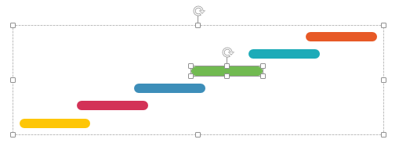

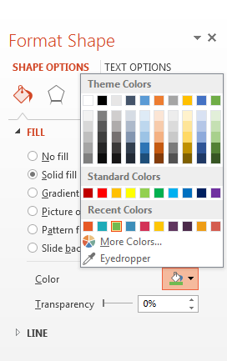
Edit Color
1
2
3
Right click on the object or shape that you want to change the color of.
Choose Format Shape in the dialog box.
Choose “Fill” in the Format Shape box then “Solid” or “Gradient” depending on the appearance of the object. Change colour as shown in the picture.

