Slide 1
World Map Countries
This slide is 100% editable. Adapt it to your needs and capture your audience's attention. This slide is 100% editable. Adapt it to your needs and capture your audience's attention.
Canada
90%
20%
Brazil
90%
Africa
75%
75%
Australia
60%
60%
50%
Russia
50%
20%
This slide is 100% editable. Adapt it to your needs and capture your audience's attention. This slide is 100% editable. Adapt it to your needs and capture your audience's attention. This slide is 100% editable. Adapt it to your needs and capture your audience's attention. This slide is 100% editable. Adapt it to your needs and capture your audience's attention. This slide is 100% editable. Adapt it to your needs and capture your audience's attention.

Slide 2
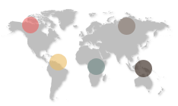
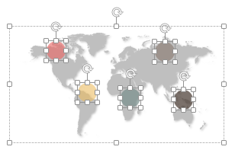
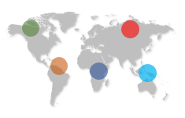
All images are 100% editable in PowerPoint
“Change color, size and orientation of any icon to your liking”

Slide 3
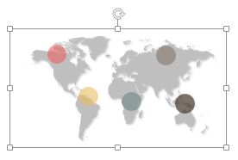

Ungrouping the object
1
2
3
The icons we have shown are just for demo purposes. You can replace these icons with the correct icons to suit your message. We have a large collection of icons to choose from.
To replace any icon, double click on it and select it, and then right click it to ungroup it.
Delete the icon and replace it with any icon or graphic from our site.

Slide 4
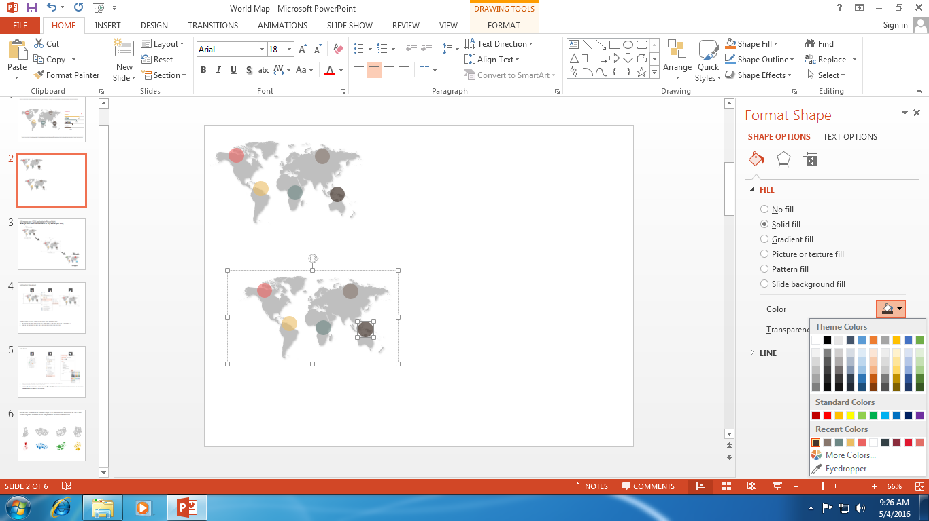

Edit Color
1
2
3
Right click on the object or shape that you want to change the color of.
Choose Format Shape in the dialog box.
Choose “Fill” in the Format Shape box then “Solid” or “Gradient” depending on the appearance of the object. Change colour as shown in the picture.

Slide 5
Select from Thousands of editable maps in all countries and continents of The World
These maps are available at the Maps section on www.slideteam.net

