Slide 1
Six Steps Timeline Planning Diagram
01
03
05
Text Here
Text Here
Text Here
Download this awesome diagram. Capture your audience’s attention.
Download this awesome diagram. Capture your audience’s attention.
Download this awesome diagram. Capture your audience’s attention.
2012
2013
2014
2015
2016
2017
Text Here
Text Here
Text Here
Download this awesome diagram. Capture your audience’s attention.
Download this awesome diagram. Capture your audience’s attention.
Download this awesome diagram. Capture your audience’s attention.
02
04
06

Slide 2

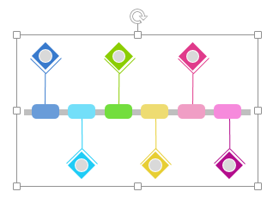
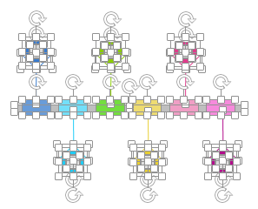
All images are 100% editable in PowerPoint
“Change color, size and orientation of any icon to your liking”
Ungrouping the object
2
1
3
Right click the object.
Choose Group and then Ungroup.
Click beside the object and drag the arrow over it.

Slide 3
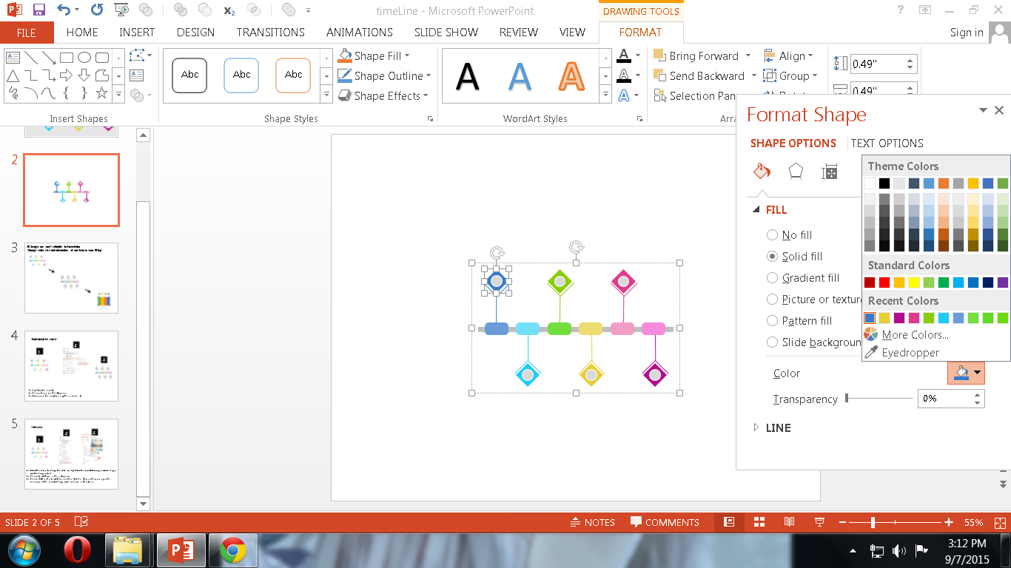

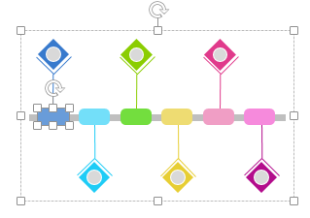
Edit Color
2
3
1
Select the shape to change the color and Right click the object( click any object which you want to change color)
Choose Format Shape in the dialog box.
Choose “Fill” in the Format Shape box then “Solid” or “Gradient” depending on the appearance of the object. Change colour as shown in the picture.

