Slide 1
Road Infographic For Planning
03
Download this awesome diagram. Bring your presentation to life. Capture your audience’s attention.
option
05
01
Download this awesome diagram. Bring your presentation to life. Capture your audience’s attention.
Download this awesome diagram. Bring your presentation to life. Capture your audience’s attention.
option
option
04
Download this awesome diagram. Bring your presentation to life. Capture your audience’s attention.
option
02
Download this awesome diagram. Bring your presentation to life. Capture your audience’s attention.
option

Slide 2

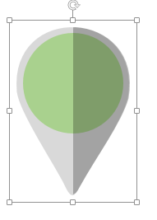
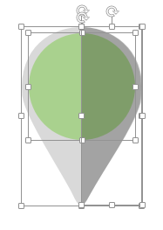
All images are 100% editable in PowerPoint
“Change color, size and orientation of any icon to your liking”
Ungrouping the object
2
1
3
Right click the object.
Choose Group and then Ungroup.
Click beside the object and drag the arrow over it.

Slide 3
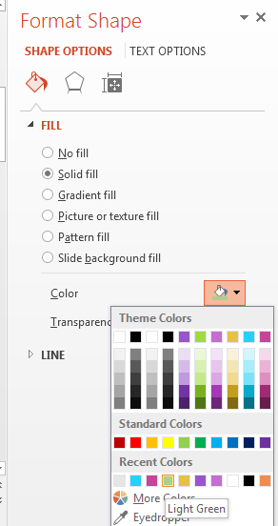

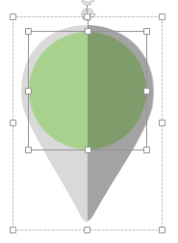
Edit Color
2
3
1
Select the shape to change the color and Right click the object( click any object which you want to change color)
Choose Format Shape in the dialog box.
Choose “Fill” in the Format Shape box then “Solid” or “Gradient” depending on the appearance of the object. Change colour as shown in the picture.

