Slide 1
Graph On Tablet For Segmentation Strategy
Text Here
Download this awesome diagram.
Text Here
E
Download this awesome diagram.
Text Here
D
Download this awesome diagram.
Text Here
Download this awesome diagram.
C
Text Here
Download this awesome diagram.
65%
B
55%
A
45%
35%
25%

Slide 2

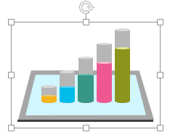
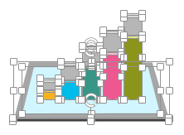
All images are 100% editable in PowerPoint
“Change color, size and orientation of any icon to your liking”
Ungrouping the object
2
1
3
Right click the object.
Choose Group and then Ungroup.
Click beside the object and drag the arrow over it.

Slide 3
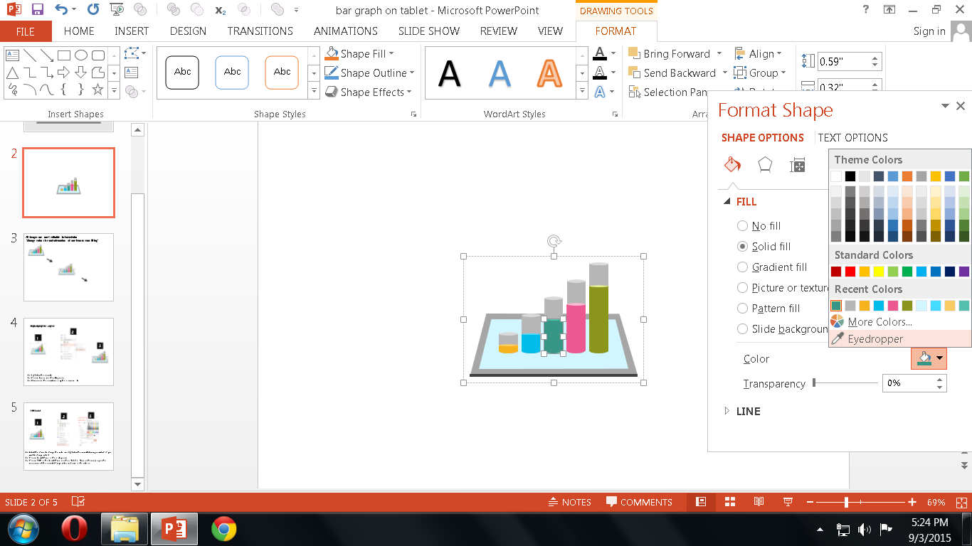

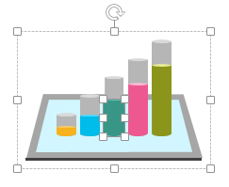
Edit Color
2
3
1
Select the shape to change the color and Right click the object( click any object which you want to change color)
Choose Format Shape in the dialog box.
Choose “Fill” in the Format Shape box then “Solid” or “Gradient” depending on the appearance of the object. Change colour as shown in the picture.

